Slide 1
Video 1: What is CADS?
Maria Leedham
Full resource: https://www.ncrm.ac.uk/resources/online/all/?id=20855

Slide 2

What is CADS?
CADS = Corpus-Assisted Discourse Studies
CADS combines corpus linguistics + discourse studies
Starts from a social issue
A mixed methods approach to language analysis
Notes:
Corpus-Assisted Discourse Studies (CADS) is a mixed-method approach that combines the computational power of corpus linguistics with the interpretive insights of discourse analysis.
Social issue could be a problem in society. CL alone might analyse an area of language just to know more about it. CADS starts from a social issue. This could be .... examples

Slide 3

What is corpus linguistics?
Corpus (sing), corpora (pl) = An organised collection of digital texts
A branch of linguistics which studies corpora using computer software to understand how language is used in context
Notes:
Corpus – from the Latin for body – plural corpora – systematically collected body of language
Corpus analysts compile a corpus and then explore this using software

Slide 4
Why use corpus linguistics?
To quickly explore a large quantity of text: 'the language looks rather different when you look at a lot of it at once' (Sinclair 1991:100)
To slice through the data in different ways and thus obtain fresh perspectives
To reveal language patterns the human eye may not notice
Can combine quantitative and qualitative analysis
Notes:
Corpus – from the Latin for body – plural corpora – systematically collected body of language
Corpus analysts compile a corpus and then explore this using software
Why do this?
can slice through the data in different ways and thus obtain fresh perspectives while retaining the wider context of individual texts. So you can zoom in and out of the texts. And see a lot of language within a lot of texts at once. Gives the analyst a new perspective
Used in linguistics to explore how language works eg language learning, lexicography, translation, but also across the social sciences to explore a wide range of texts in one go for example CASS studies

Slide 5
Types of corpora
Notes:
Corpora now range from billions of words scraped from websites to small, carefully-formed corpora e.g. 10,000 words of facebook updates from a specific range of individuals.

Slide 6
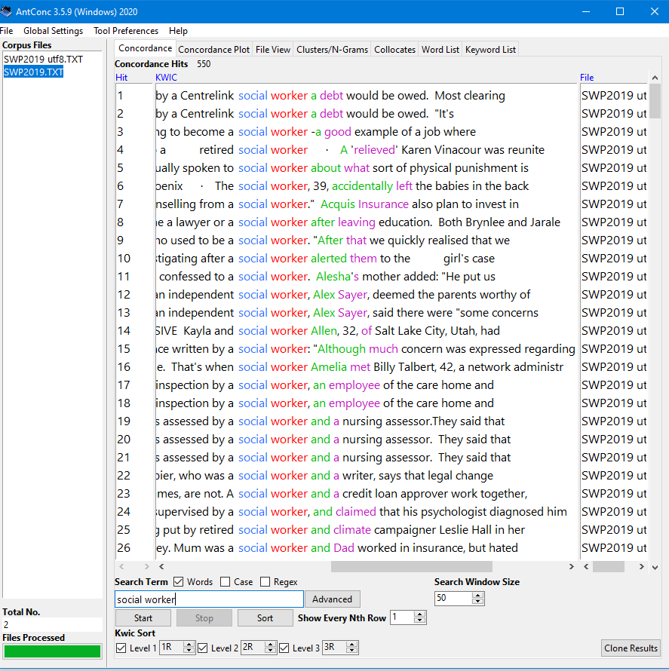
Ways of analysing a corpus
Descriptive statistics on mean sentence length, variety of lexical items used, (per text and for the whole corpus)
Produce frequency word or phrase lists
Get concordance lines and sort these in different ways
Look at collocate lists for insight into the data
Find key words and phrases compared to a reference corpus
Look at plot dispersions to see how a linguistic feature is used across whole texts/the corpus
Search for similar lexical items/chunks through semantic or Part of Speech tagging
Notes:
triangulation

Slide 7


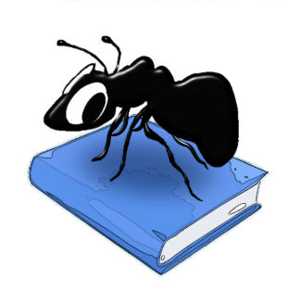


Corpus software
Notes:
To explore corpora, you need corpus software.
WordSmith Tools: http://www.lexically.net/wordsmith/ (download, c.£50)
Wmatrix: http://ucrel.lancs.ac.uk/wmatrix/ (online, c. £50 p.a.)
Antconc: https://www.laurenceanthony.net/software/antconc/ (download, free)
SketchEngine: https://www.sketchengine.eu/ (online, some free access, may have uni login)
LancsBox #LancsBox X (download, free)

Slide 8
What is discourse analysis?
Discourse = meaning making through language above the level of the sentence
“The analysis of language-in-use whether spoken or written. Linguistic forms of discourse analysis pay attention to the details of grammar and how they function in communication. Other forms of discourse analysis pay attention only to themes and messages (sometimes this is called ‘content analysis’)”
James Paul Gee, 2010:205
Notes:
discourse is often described as meaning making through language above the level of the sentence
within the social sciences, the word discourse is often described

Slide 9
Why use discourse analysis?
To study what humans do with language and how we do it
To gain rich insights from attention to a small number of texts
To explore how people build meaning through repeated use of particular language patterns
Notes:
discourse is often described as meaning making through language above the level of the sentence
Texts may have different status, depending on text producer/receiver and the context
Attention to texts-in-context. Text analysis includes internal and external dimensions (e.g. texts as artefacts)

Slide 10
Ways of analysing discourse
Read individual texts and form hypotheses
Extract randomised examples and manually code (within corpus software, qual software, Excel, etc)
Thematic analysis of language data
Draw on interviews/ focus groups /survey /contextual data to inform the textual data
Notes:
triangulation

Slide 11
CADS tools and techniques
From corpus software:
From discourse analysis:
concordancing
frequency lists
collocates
plot dispersions
keywords
automated semantic tagging
...
critically read texts
qualitative analysis of a sample of language data
manually code randomised examples
thematic analysis
combining text analysis with participant data (e.g. interviews, focus groups, surveys, contextual data)
...
Notes:
What you can do with a corpus
Descriptive statistics on mean sentence length, variety of lexical items used, (per text and for the whole corpus)
Produce frequency word or phrase lists
Get concordance lines and sort these in different ways
Look at collocate lists for insight into the data
Find key words and phrases compared to a reference corpus
Look at plot dispersions to see how a linguistic feature is used across whole texts/the corpus
Search for similar lexical items/chunks through semantic or Part of Speech tagging
Combine with discourse analysis techniques
Read individual texts and form hypotheses
Extract randomised examples and manually code (within corpus software, qual software, Excel, etc)
Thematic analysis
Draw on interviews/ focus groups /survey /contextual data to inform the textual data

Slide 12
Combining corpus linguistics and discourse analysis allows
different 'ways in' to data analysis

